Slide 1
How do Satellites Help us Understand More About Climate Change and the Earth
By all members of robot club in All Saints School 2017

Slide 2
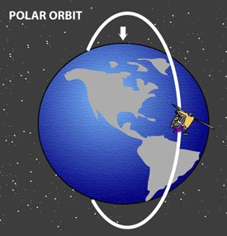
Polar Satellites
It circles the planet in a north-south direction as Earth spins beneath it in an east-west direction.
It is 350,900km away from Earth.
Polar Orbits allow satellites to scan the whole surface of the Earth.
Remote sensing satellites, weather satellites, and government satellites are nearly always in polar orbit because of the coverage.
All polar orbiting satellites meet at The North Pole.
When one Polar orbit satellite is over America, another Polar Satellite is flying over the North Pole.

Slide 3
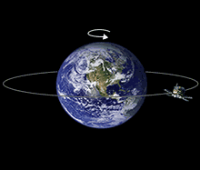
Geostationary Satellite
It orbits directly over the equator orbiting from west to east.
It goes the same speed as the Earth does.
It stays around the equator.
It tracks Weather.
There are lots of them.
It looks at the same place all the time.
It orbits at an altitude of 35,800km (22,300 miles)

Slide 4
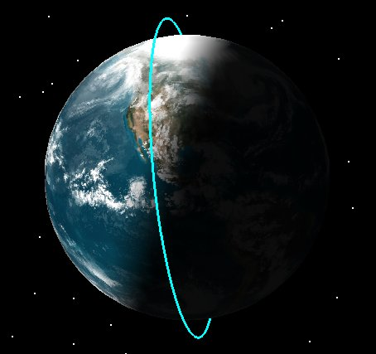
Sun-Synchronous Satellite
Passes the same point of the Earth at the same local time.
Follows the same path as the Polar Satellite.
Earth observation satellites follow the sun synchronous orbits most of the time.
The satellite travels from the north to the south pole.
There is a special kind of sun-synchronous orbit called a dawn-to-dusk orbit.In a dawn-to-dusk orbit, the satellite trails the Earth's shadow.

Slide 5
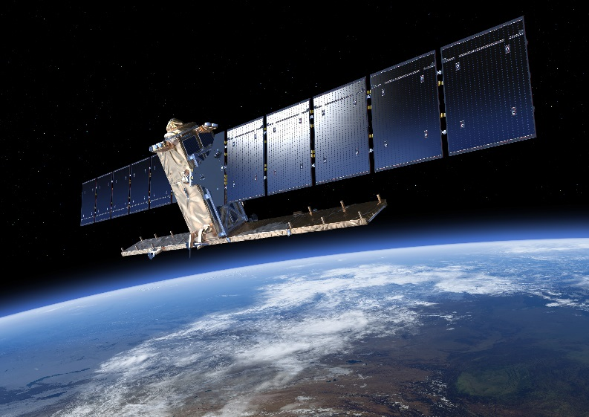
Sentinel 1
Sentinel 1 is a Satellite which was launched April 3rd 2014.
It’s launch mass is 2,300 kg (kilograms).
Sentinel-1A launched first followed by 1B.
It measures land/surface height using radar.

Slide 6
Why use radar?
Synthetic Aperture Radar (SAR) has the advantage of operating at wavelengths not stopped by cloud cover or a lack of illumination and can acquire data over a site during day or night time under all weather conditions.

Slide 7

What is radar?
Radar can detect solid objects
Radio waves transmitted by the radar bounce off objects
You can work out the distance to an object because you know the speed of the radio wave and can time how long it takes to come back

Slide 8
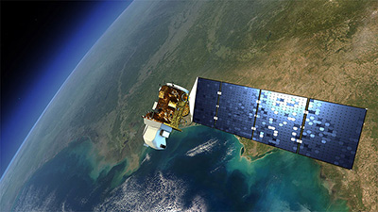
Landsat 8
It’s launch date is 11 February 2013.
It’s Period is 1.6 hours.
It uses a Geostationary orbit.
It’s Launch site is Vandenberg Air Force base, Vandenberg AFB Space Launch Complex 3.

Slide 9
Landsat 8
Uses infrared light to measure the temperature of the earth
Can build land/sea surface temperature maps
Clouds absorb infrared light so satellite can only see the top of the clouds.

Slide 10

The End!!!

